Slide 1
THE DUNGEON OF BORK 2
Eric Grant

Slide 2
Experimentation,
Randomization,
Classes &
What Not To Do

Slide 3
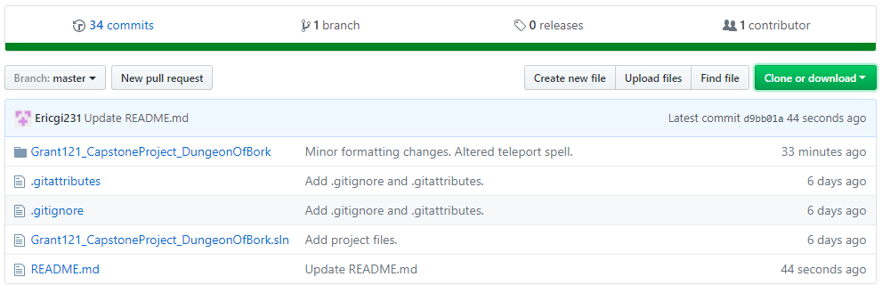
Randomization - Can’t Show It All
Search for “Grant121_Capstone” on Github

Slide 4
Live Demo

Slide 5
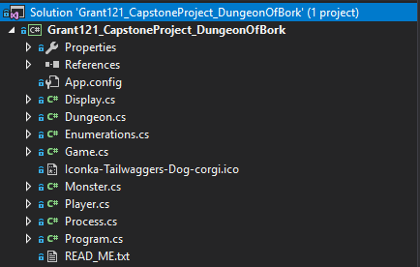
Classes - The Big Picture
Game
Display & Process
Monster & Player
Dungeon
Enumerations

Slide 6
Display & Process

Slide 7
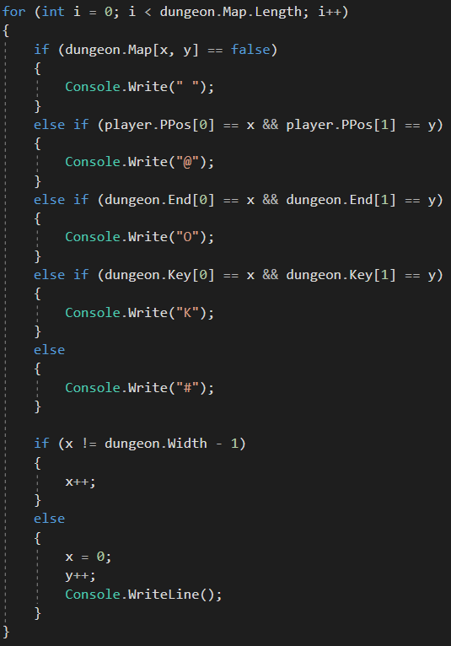
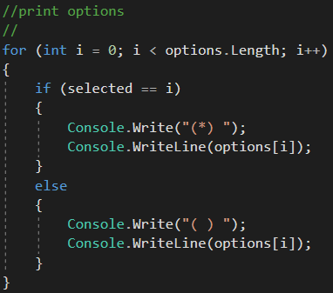
Menu - What You See

Slide 8
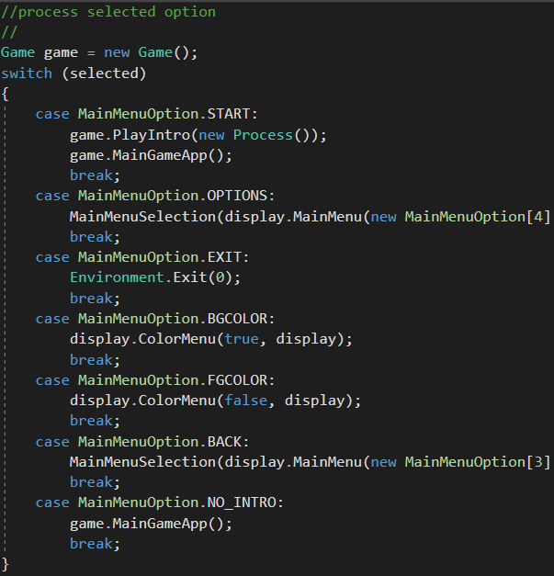
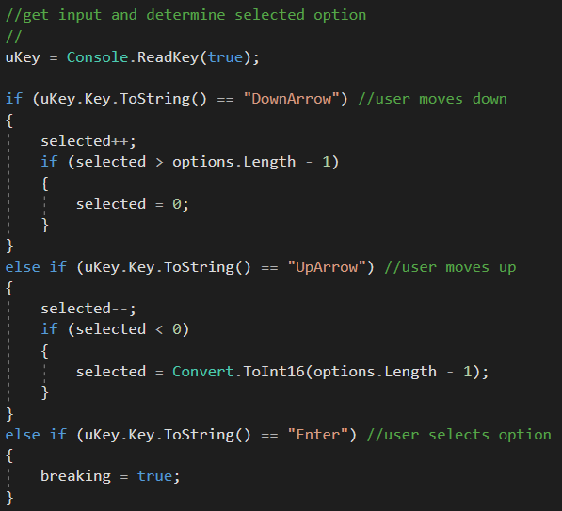
Menu - How It Works

Slide 9
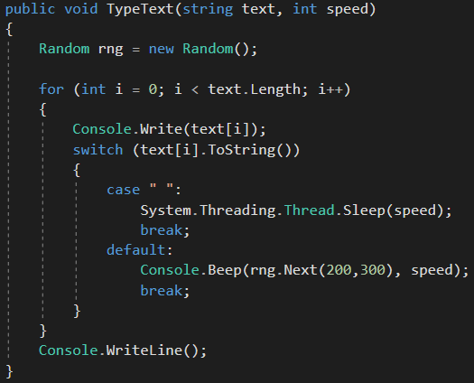
Type Text
A neat idea I forced in.

Slide 10
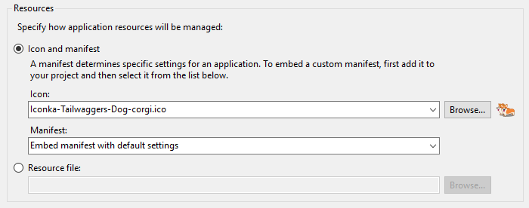
Icons - Easier Than You Thought

Slide 11
Enumerations

Slide 12
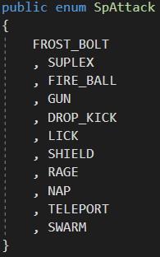
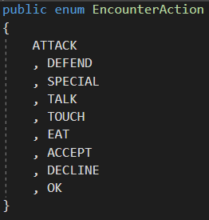
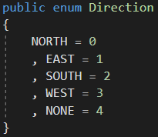
Enumerations - A Big Mess

Slide 13
Dungeon

Slide 14
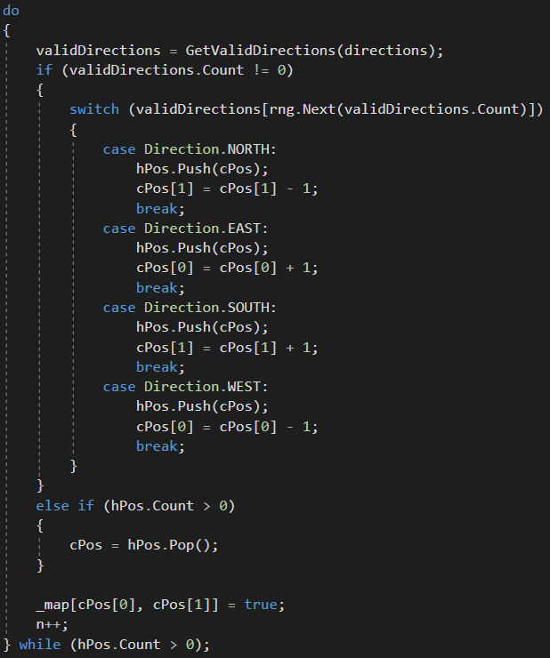
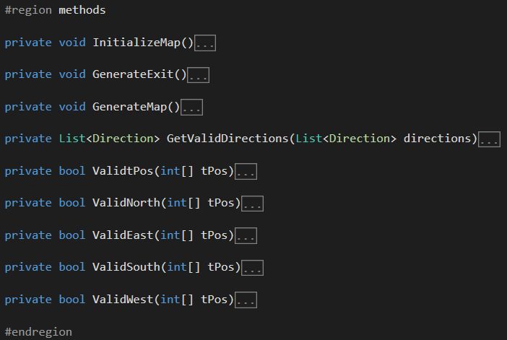
Making A Map - Grid Of Bool

Slide 15
Player & Monster

Slide 16
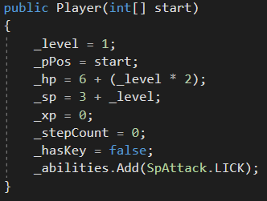
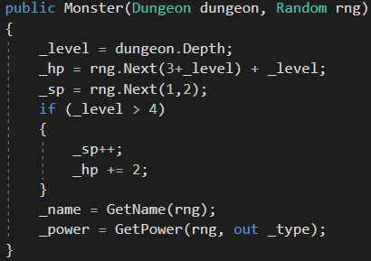
Players & Monsters - Quite Alike

Slide 17
Game

Slide 18
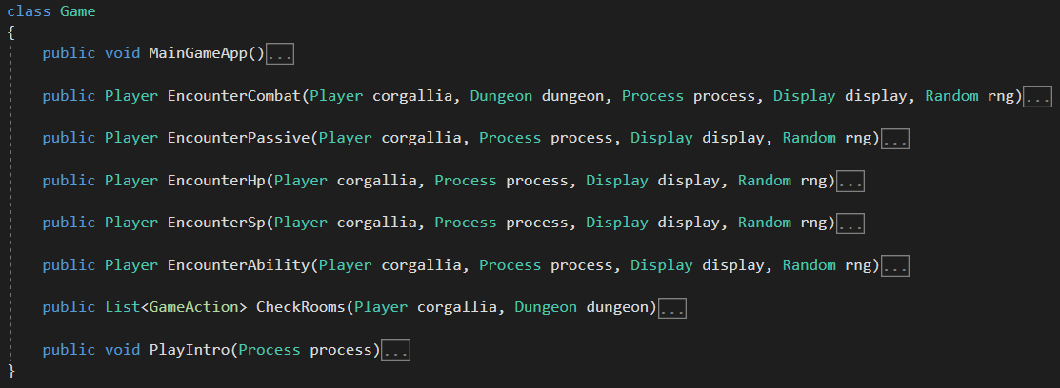
Game - The Powerhouse of The Cell

Slide 19
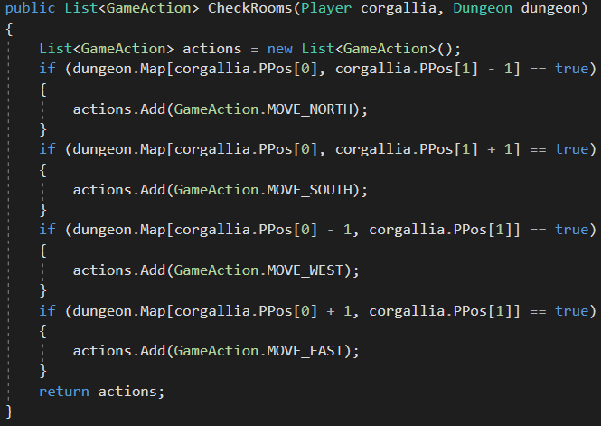
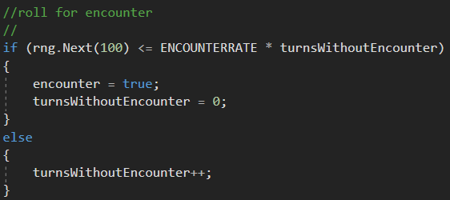
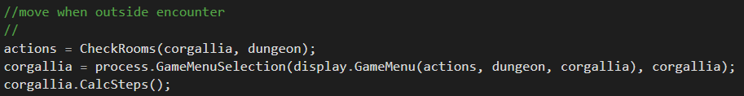
Game - The Loop

Slide 20
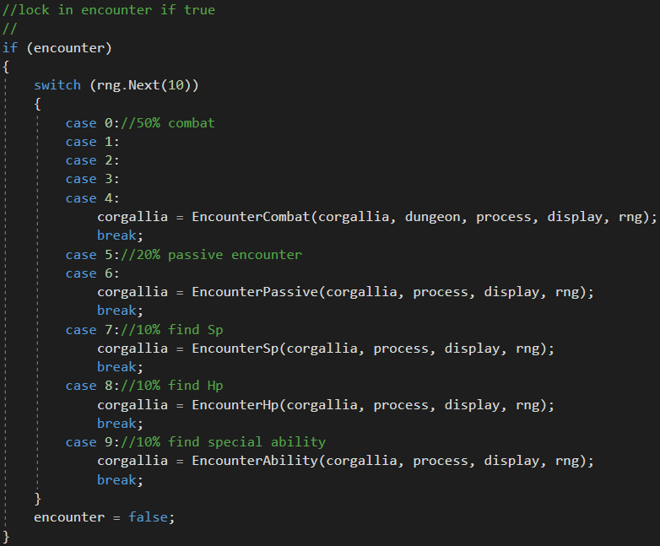
Encounters
A break from the loop.
A pain in the patoot.

Slide 21
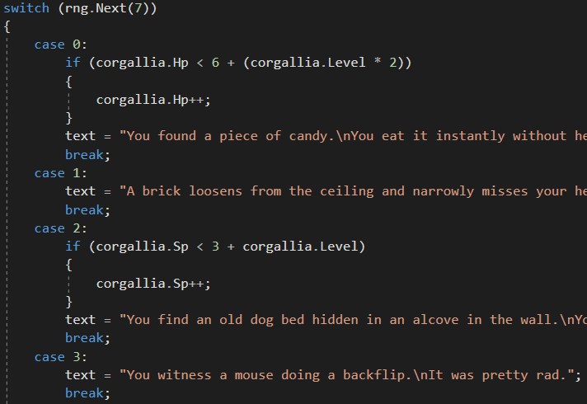
Passive

Slide 22
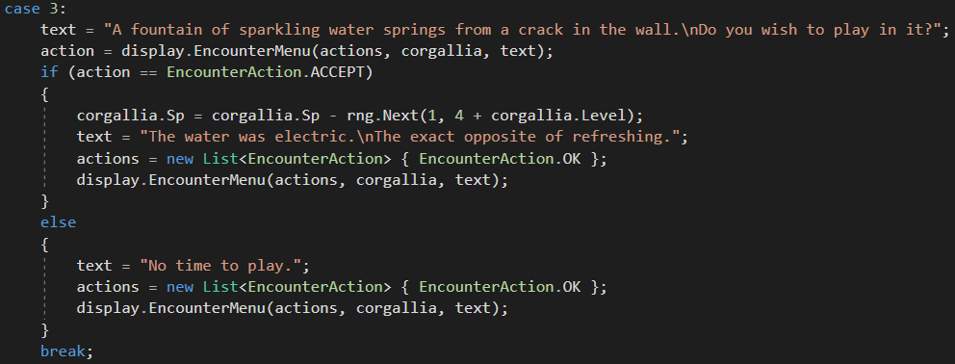
Active

Slide 23
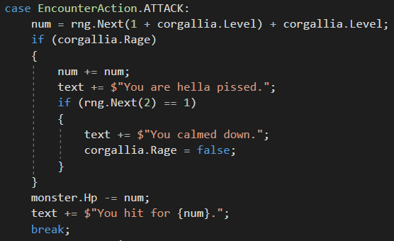
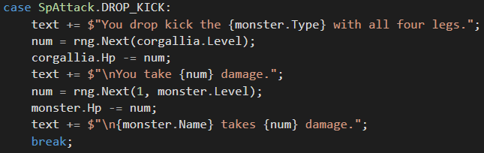
Combat

Slide 24
The rise & fall

Slide 25
Comments or
Questions?

